Slide 1
Digital Electronics (EE221)

Slide 4
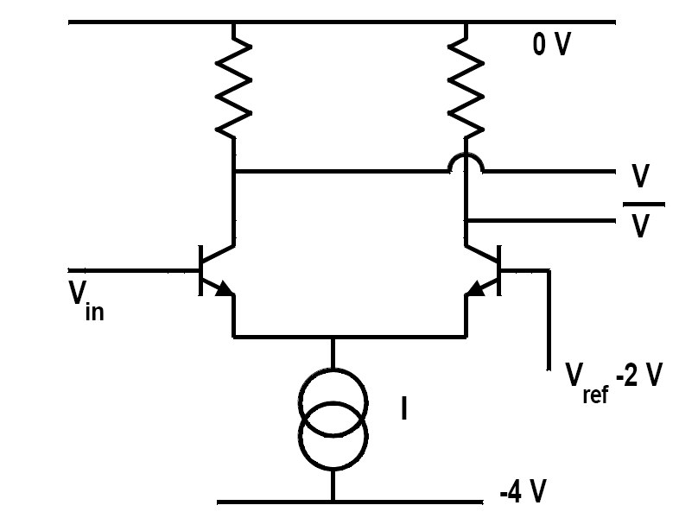

Slide 6
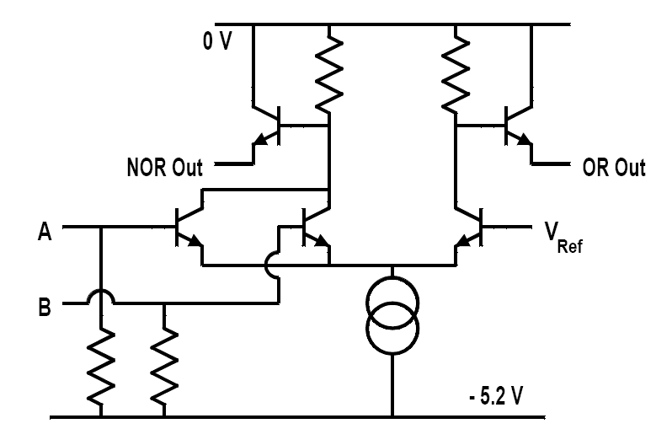

Slide 7
